Slide 1


F I N A L Y E A R P R O J E C T P R E S E N T A I O N
Machine Learning based Secret Key Generation
Department: B.Sc. – IT - Cloud Technology and Information Security
TECHNO INDIA UNIVERSITY
Presented by:
Subhom Acharjya (201001112003)
Ritabrata Sinha (201001112001)

Slide 2
C O N T E N T
01 Abstract
02 Motivation
03 Introduction
04 Requirements
05 Features
06 Till now status of project
07 Remaining part of the project
08 Reference
2

Slide 3
ABSTRACT
This project aims to develop a machine learning-based approach for generating secure secret keys for cryptographic applications. The proposed system uses a combination of evolutionary algorithms and deep learning models to generate complex and unpredictable keys that can withstand attacks from adversaries.

Slide 4
MOTIVATION
Our motivation for developing a project on secret key generation based on machine learning is primarily driven by the need to enhance security and privacy in various applications that require cryptographic protection. Traditional key generation techniques, such as random number generation, suffer from several drawbacks, including predictability and lack of randomness, which can make them vulnerable to attacks from adversaries. As a result, there is a growing need for more efficient and secure key generation techniques that can provide a higher level of protection against attacks.
4

Slide 5
INTRODUCTION
In today's digital age, the security and privacy of information have become crucial concerns. Cryptography is a fundamental technique that enables secure communication, data protection, and digital authentication by converting plaintext data into an unintelligible form using secret keys.
Machine learning has emerged as a promising technique for improving the security and strength of secret keys. Evolutionary algorithms and deep learning models have shown great promise in generating complex and unpredictable keys that can withstand attacks from adversaries. The goal of this project is to develop a machine learning-based approach for secret key generation that can provide improved security and strength compared to traditional key generation techniques.
5

Slide 6
REQUIREMENTS
System Requirement:
PC , laptop, Mobile etc. with any OS
Technology Requirement:
Python
Matlab
Tools Requirement:
VS code

Slide 7
F E A T U R E S
Secret Key Generation
Enhancing Digital Authentication
OTP generation
Secure Communication
Data Protection

Slide 8


CURRENT STATUS OF PROJECT
Understanding Secret Key and Cryptography
Researching Chaotic Map
Running and Testing a Python Algorithm based on Chaotic map
Researching Optimization Algorithm
Researching Genetic Algorithm
Running and Testing a python Algorithm based on Genetic Algorithm (Not Completed)

Slide 9
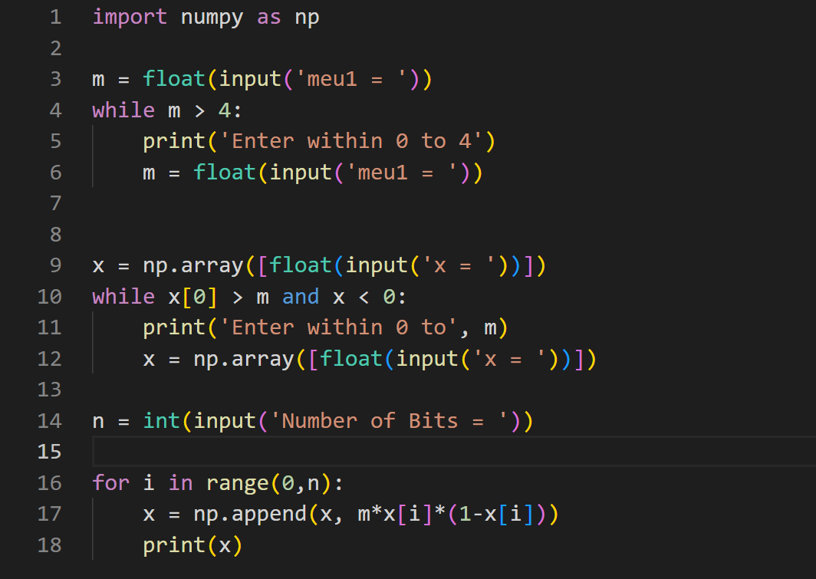
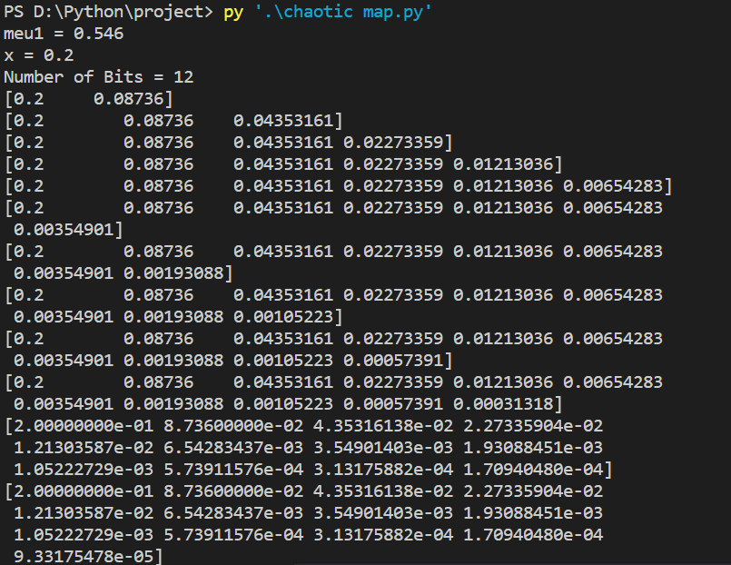
CURRENT STATUS OF PROJECT
Logistic Chaotic Map code
Output

Slide 10
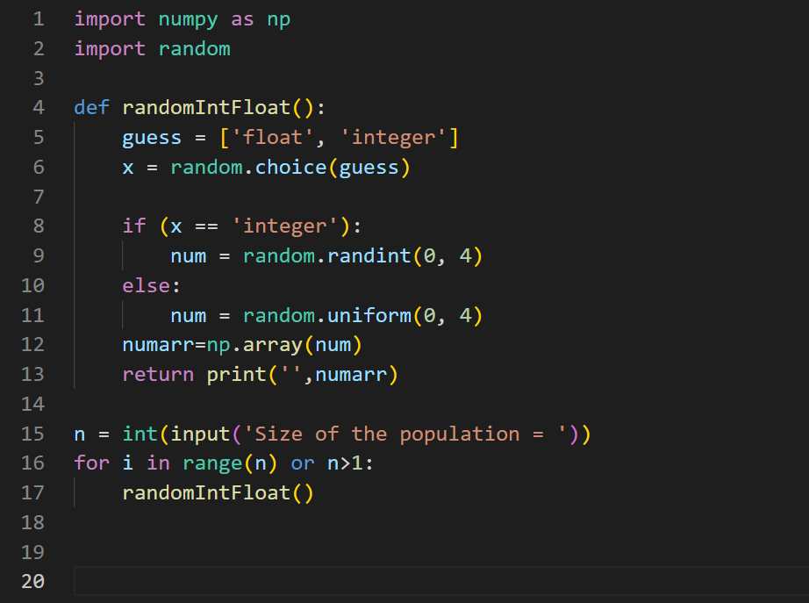
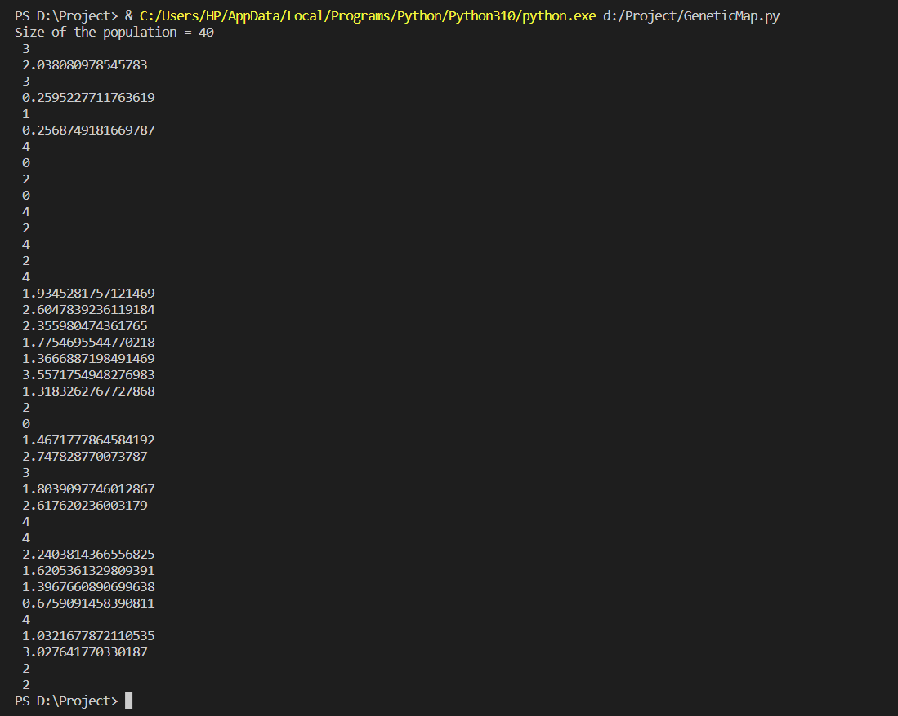
CURRENT STATUS OF PROJECT
Genetic Map Algorithm (Initial Population Encoding)
Output

Slide 11
REMAINING PART
Deeper understanding of Genetic Algorithm
Fitness Evaluation (Poker Test)
Selection (Binary Tournament Selection)
Crossover
Mutation
Running and Testing of a complete Genetic Algorithm
We wish to conclude our research within 7 to 10 days.

Slide 12
REFERENCES
List of Chaotic Map (Click Here)
Chaos Theory (Click Here)
Encoding methods in Genetic Algorithm (Click Here)
Poker Test (Click Here)
Role of Randomness in Machine Learning (Click Here)

Slide 13
THANK YOU!

